Slide 1
AWS Architecture Sharing

Slide 2
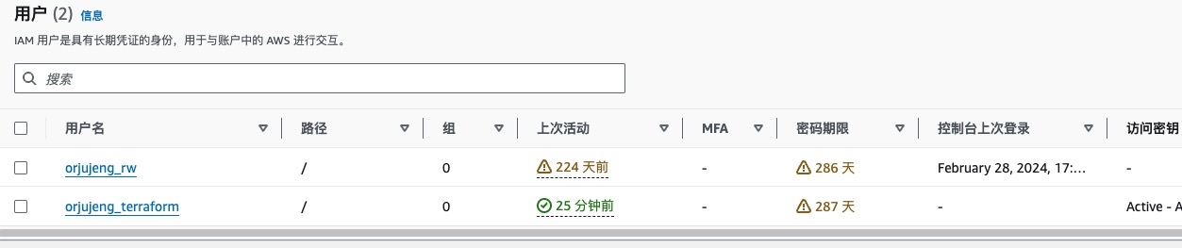
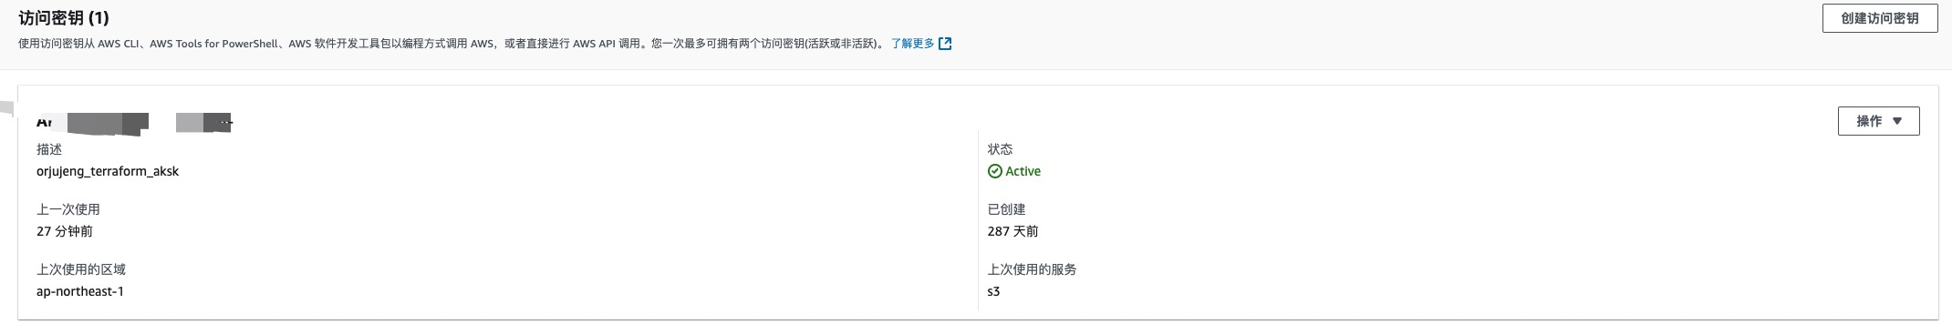
AWS Perior

Slide 3
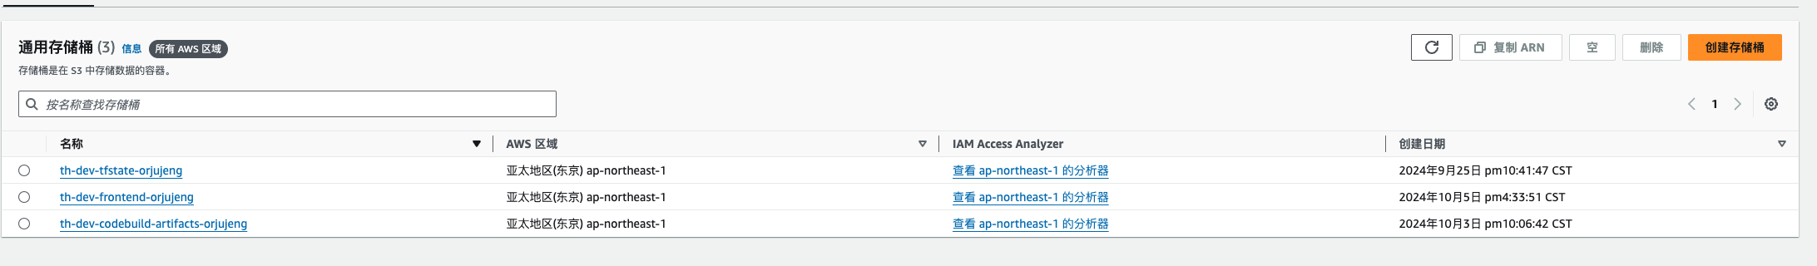

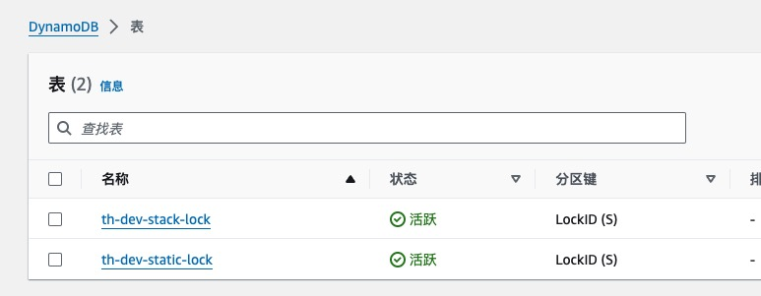

AWS Perior

Slide 4





















Architecture Overview EC2
th-dev-codebuild-artifacts-orjujeng
Amazon Simple Storage Service (Amazon S3)
ap-northeast-1
Client
Mobile client
Amazon Virtual Private Cloud (Amazon VPC)
Th-dev.orjujeng.click
AWS CodePipeline
Availability Zone ap-northeast-1a
https://github.com/orjujeng/th-backend.git
Private subnet
Git
Public subnet
Hosted zone
AWS CodeBuild
Amazon Route 53
orjujeng.click
DB instance
Instance*
bastion
th-dev.orjujeng.click
Application Load Balancer
Auto scaling
*.orjujeng.click
th-dev.orjujeng.click/api
/dev stage
http
Target group
AWS CodeDeploy
Instance*
AWS Certificate Manager (ACM)
Amazon CloudFront
Amazon API Gateway
Elastic Load Balancing
Internet gateway
Public network
origin access identity
Availability Zone ap-northeast-1c
Public subnet
Private subnet
AWS CodePipeline
Amazon Simple Storage Service (Amazon S3)
Instance*
ElastiCache
for Redis
th-dev-frontend-codepipeline
th-dev-frontend-orjujeng
AWS CodeBuild
Git
https://github.com/orjujeng/th-frontend.git

Slide 5





Architecture Overview ECS
th-dev-codebuild-artifacts-orjujeng
Amazon Elastic Container Registry (Amazon ECR)
Amazon Simple Storage Service (Amazon S3)
ap-northeast-1
Client
Mobile client
Amazon Virtual Private Cloud (Amazon VPC)
Th-dev.orjujeng.click
AWS CodePipeline
Availability Zone ap-northeast-1a
https://github.com/orjujeng/th-backend.git
Private subnet
Git
Public subnet
Hosted zone
AWS CodeBuild
Amazon Route 53
orjujeng.click
DB instance
Instance*
bastion
th-dev.orjujeng.click
Application Load Balancer
Auto scaling
*.orjujeng.click
th-dev.orjujeng.click/api
/dev stage
http
Target group
AWS CodeDeploy
AWS Certificate Manager (ACM)
Amazon CloudFront
Amazon API Gateway
Elastic Load Balancing
Blue and Green
Public network
Internet gateway
origin access identity
Availability Zone ap-northeast-1c
Provider
Public subnet
Private subnet
AWS CodePipeline
Amazon Simple Storage Service (Amazon S3)
Ec2 scaling
Amazon Elastic Container Service (Amazon ECS)
Amazon Elastic Container Service (Amazon ECS)
Instance*
ElastiCache
for Redis
th-dev-frontend-codepipeline
th-dev-frontend-orjujeng
Service
AWS CodeBuild
public.ecr.aws/orjujeng/th-dev-api
Taskdef
Git
Amazon Elastic Container Registry (Amazon ECR)
Task
https://github.com/orjujeng/th-frontend.git
Container 1
Container 2

Slide 6
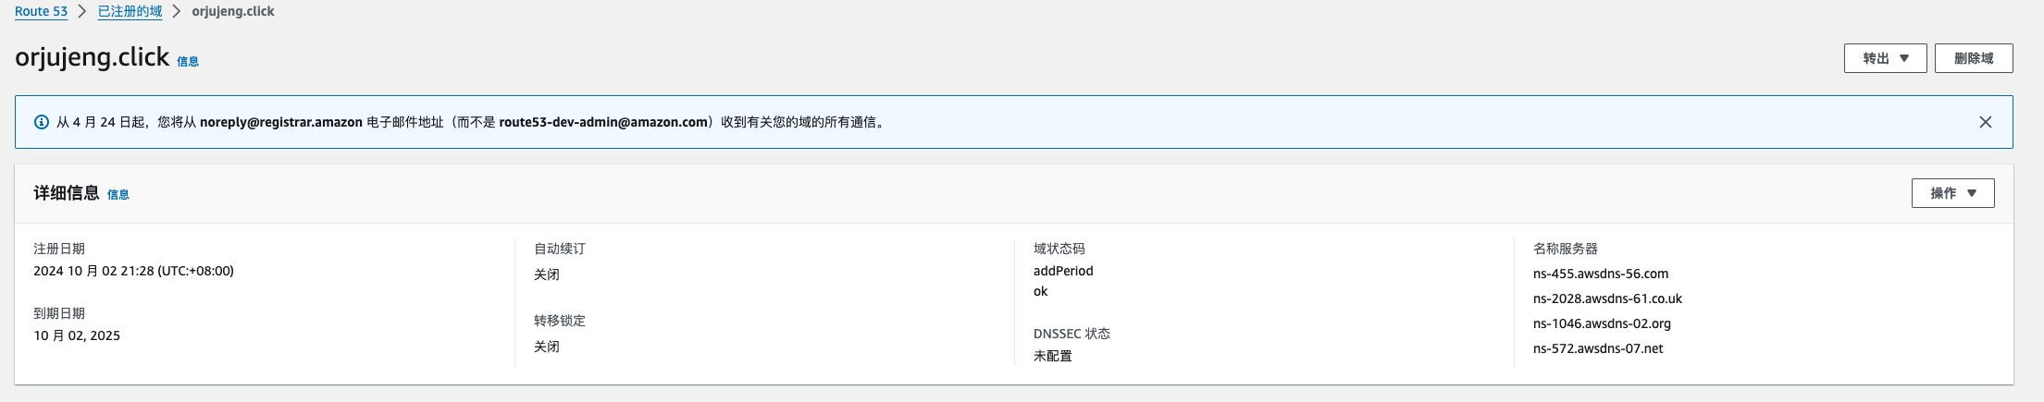
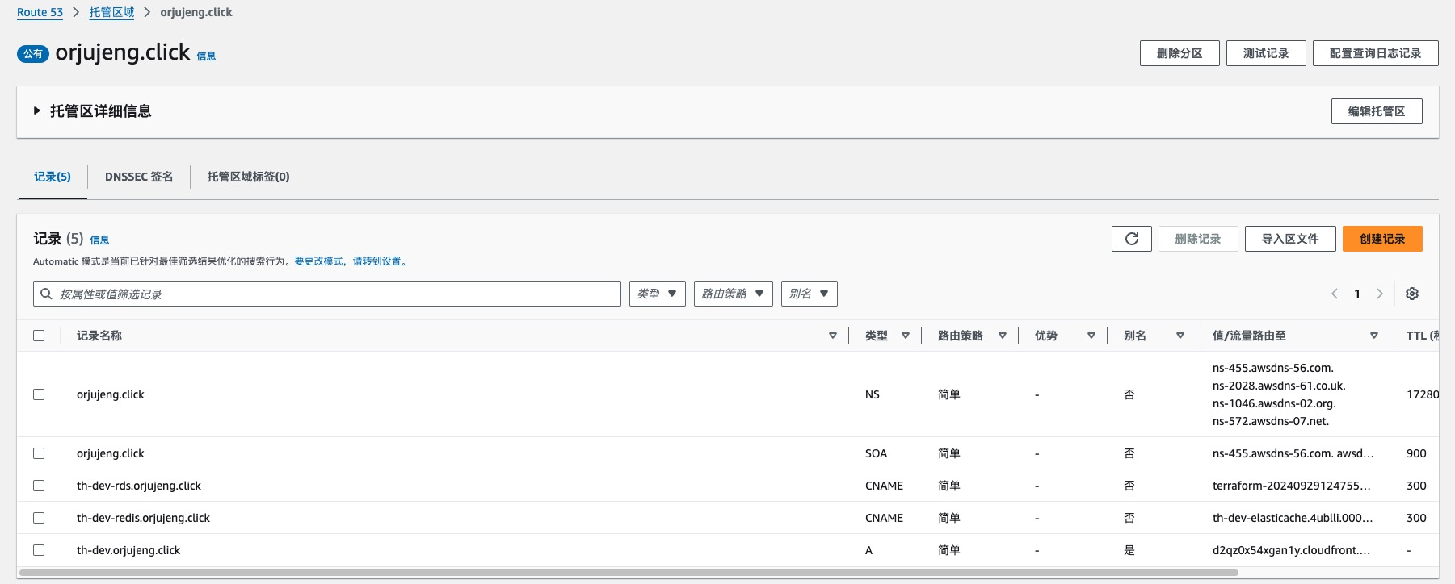
Architecture Overview ECS
Client
Mobile client
Th-dev.orjujeng.click
Hosted zone
Amazon Route 53
orjujeng.click

Slide 7
Architecture Overview ECS
th-dev.orjujeng.click
*.orjujeng.click
AWS Certificate Manager (ACM)
Amazon CloudFront
origin access identity
AWS CodePipeline
Amazon Simple Storage Service (Amazon S3)
th-dev-frontend-codepipeline
th-dev-frontend-orjujeng
AWS CodeBuild
Git
https://github.com/orjujeng/th-frontend.git

Slide 8
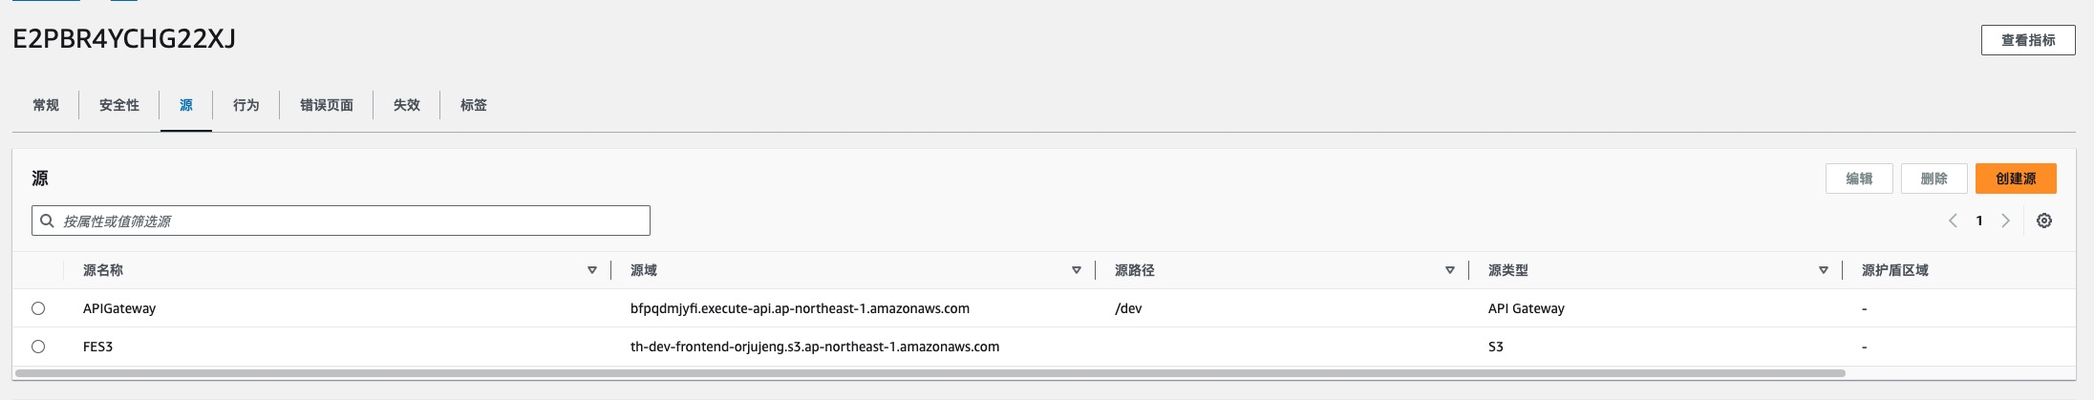
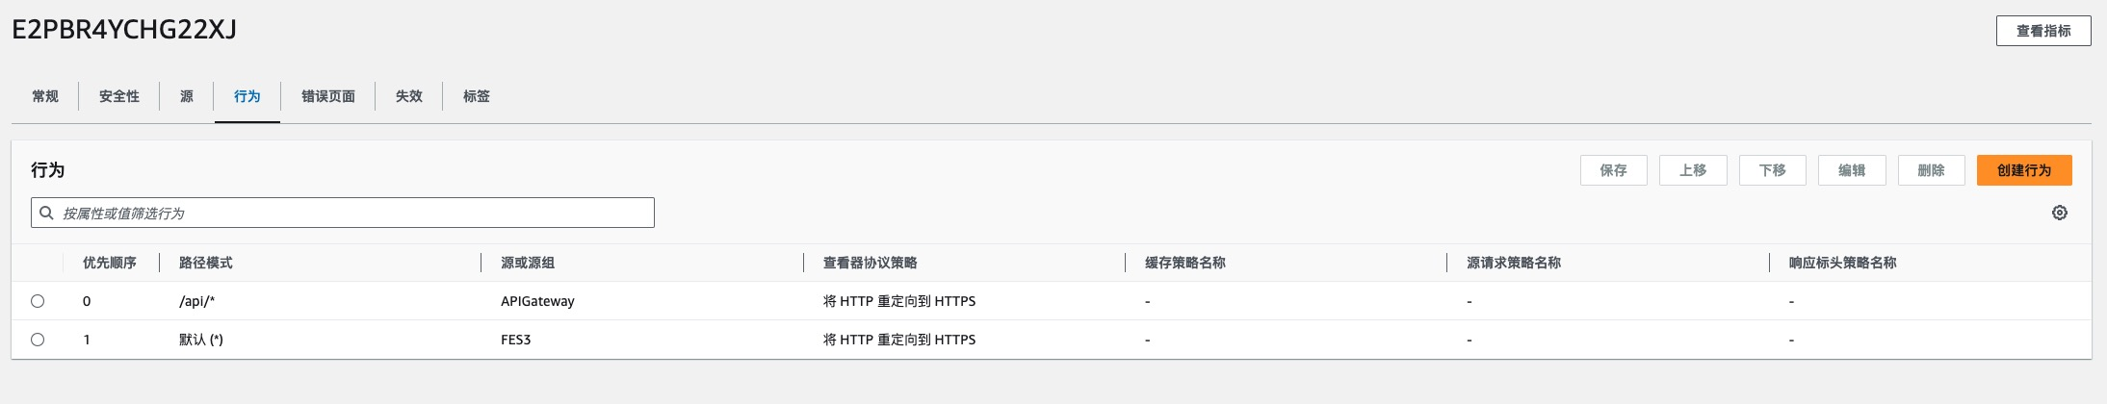
Architecture Overview ECS
th-dev.orjujeng.click
*.orjujeng.click
AWS Certificate Manager (ACM)
Amazon CloudFront
origin access identity
AWS CodePipeline
Amazon Simple Storage Service (Amazon S3)
th-dev-frontend-codepipeline
th-dev-frontend-orjujeng
AWS CodeBuild
Git
https://github.com/orjujeng/th-frontend.git

Slide 9
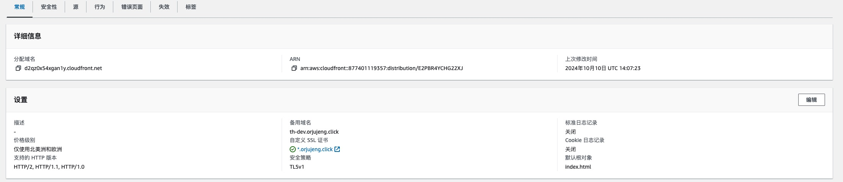
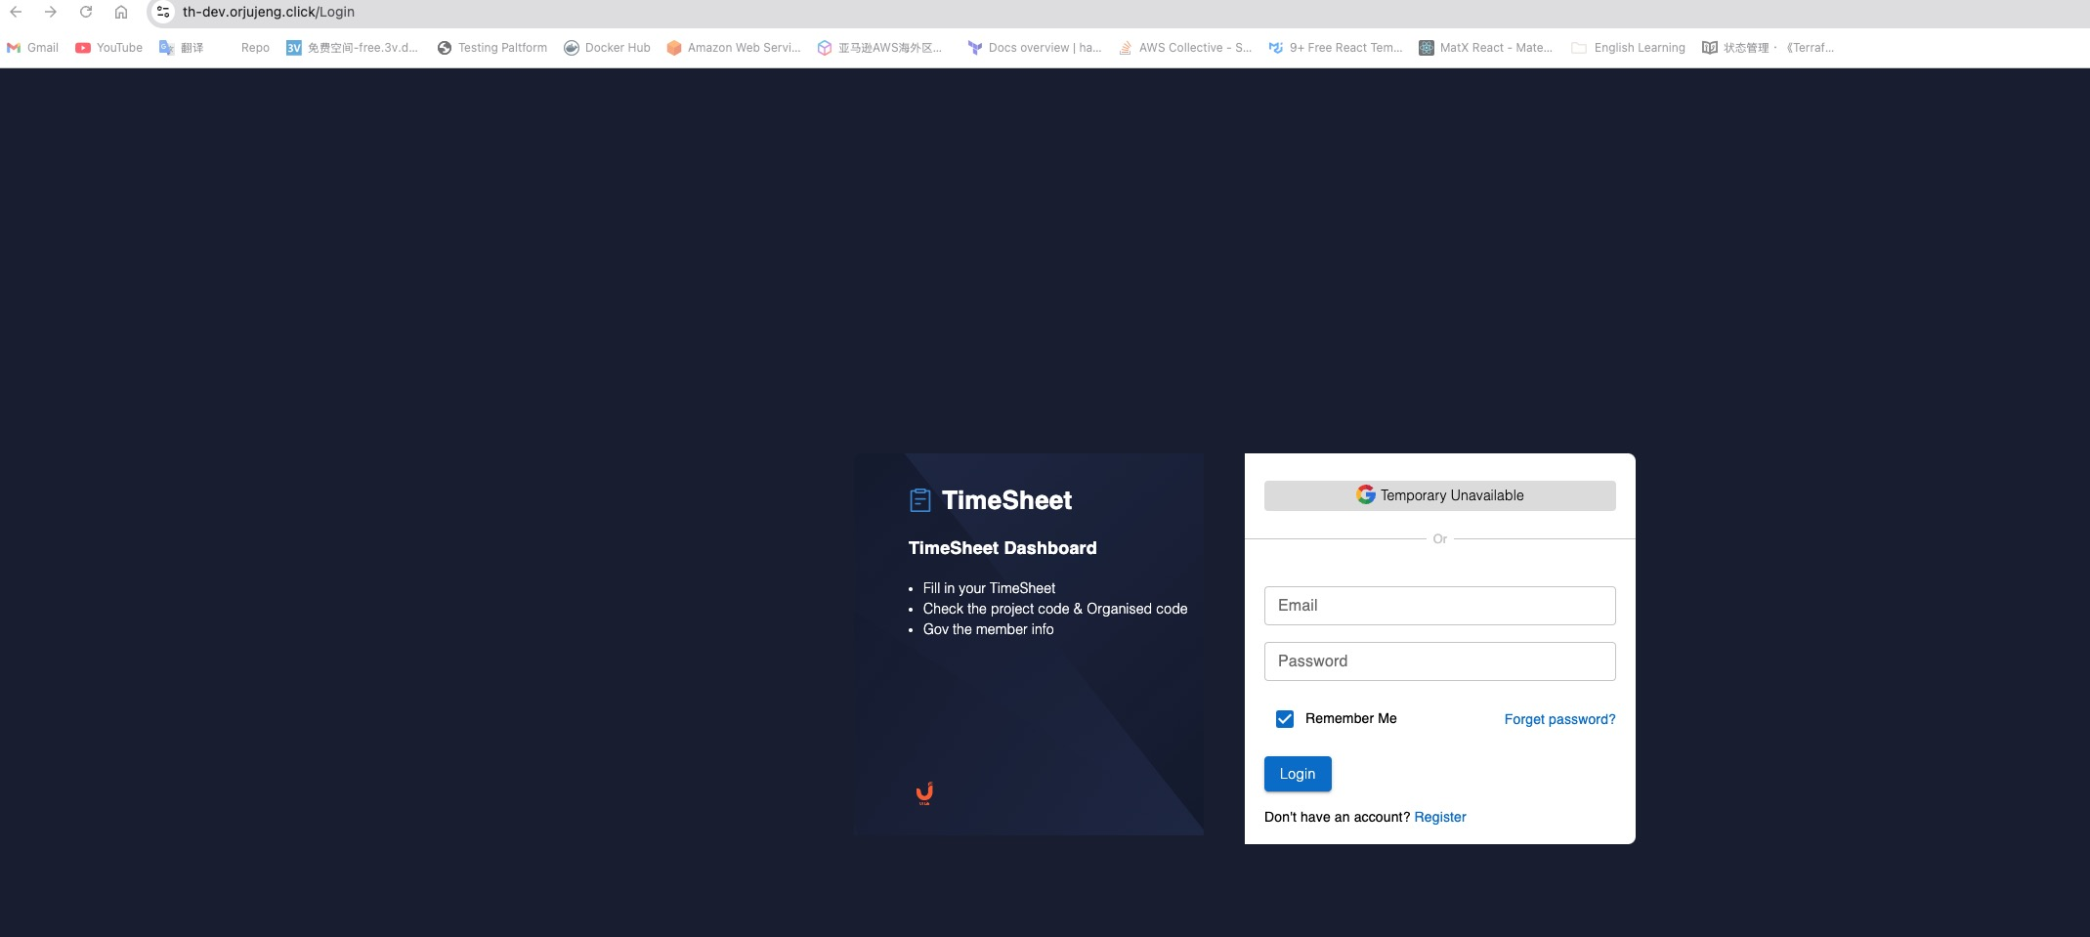
Architecture Overview ECS
th-dev.orjujeng.click
*.orjujeng.click
AWS Certificate Manager (ACM)
Amazon CloudFront
origin access identity
AWS CodePipeline
Amazon Simple Storage Service (Amazon S3)
th-dev-frontend-codepipeline
th-dev-frontend-orjujeng
AWS CodeBuild
Git
https://github.com/orjujeng/th-frontend.git

Slide 10
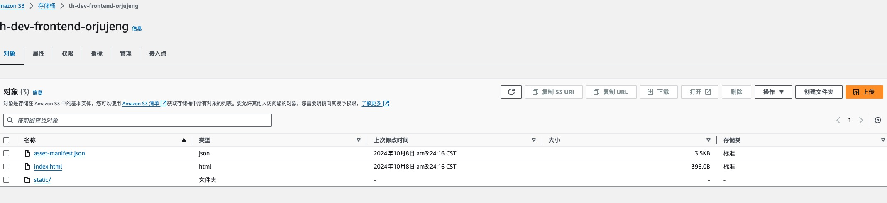
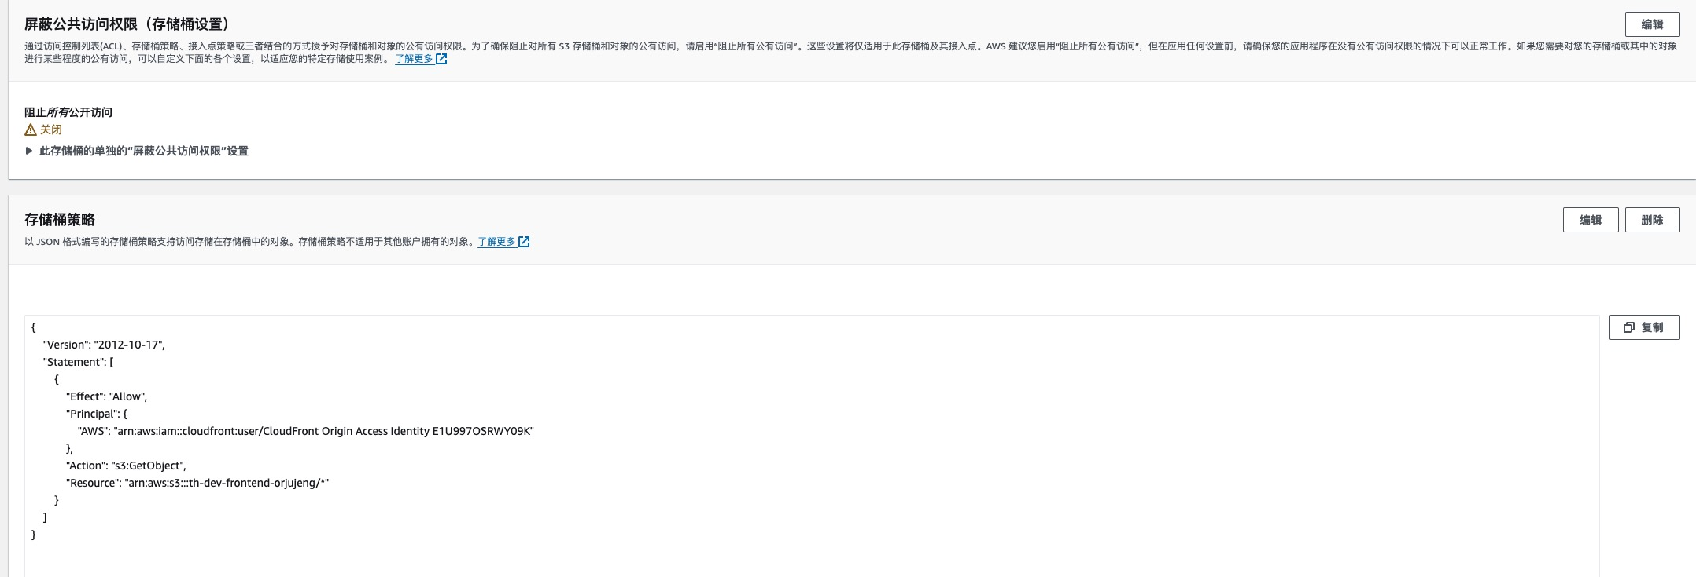
Architecture Overview ECS
th-dev.orjujeng.click
*.orjujeng.click
AWS Certificate Manager (ACM)
Amazon CloudFront
origin access identity
AWS CodePipeline
Amazon Simple Storage Service (Amazon S3)
th-dev-frontend-codepipeline
th-dev-frontend-orjujeng
AWS CodeBuild
Git
https://github.com/orjujeng/th-frontend.git

Slide 11
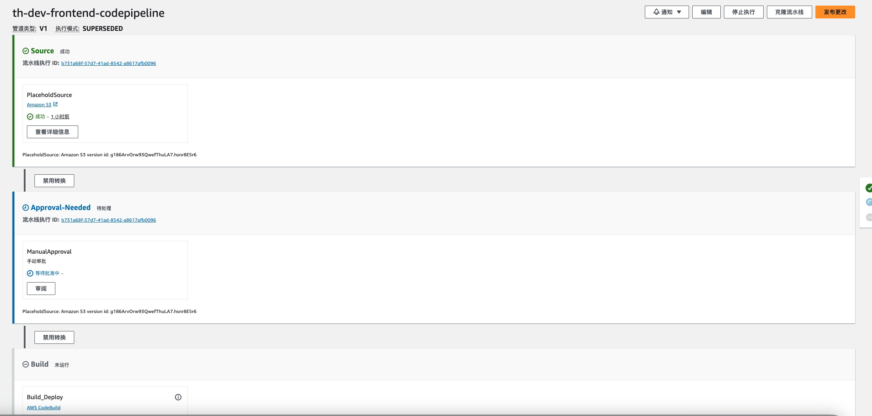
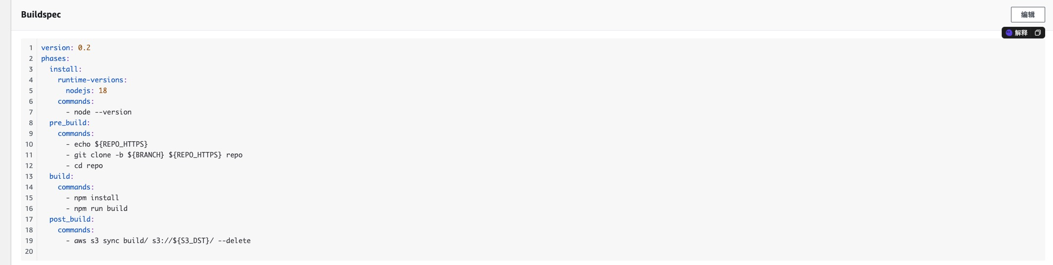
Architecture Overview ECS
th-dev.orjujeng.click
*.orjujeng.click
AWS Certificate Manager (ACM)
Amazon CloudFront
origin access identity
AWS CodePipeline
Amazon Simple Storage Service (Amazon S3)
th-dev-frontend-codepipeline
th-dev-frontend-orjujeng
AWS CodeBuild
Git
https://github.com/orjujeng/th-frontend.git

Slide 12
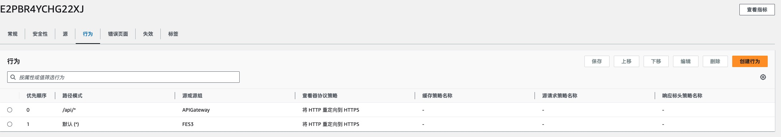
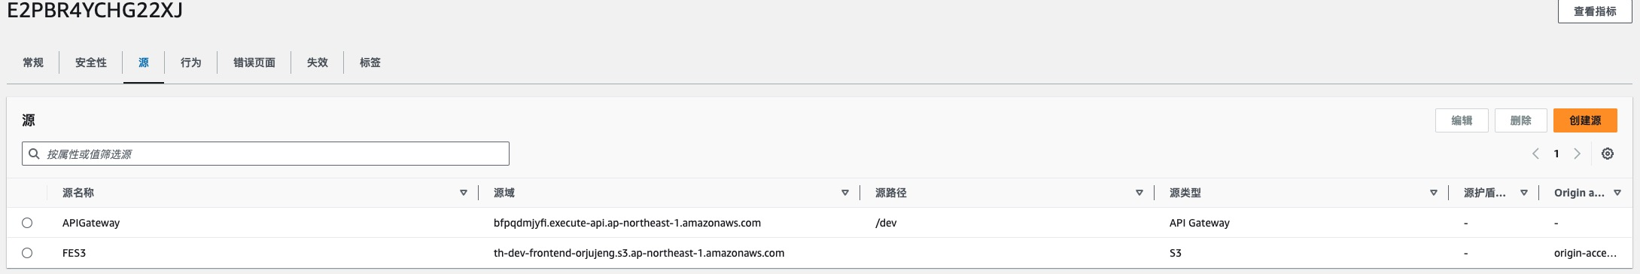
Architecture Overview ECS
Application Load Balancer
Auto scaling
th-dev.orjujeng.click/api
/dev stage
http
Target group
Amazon CloudFront
Amazon API Gateway
Elastic Load Balancing
Blue and Green

Slide 13
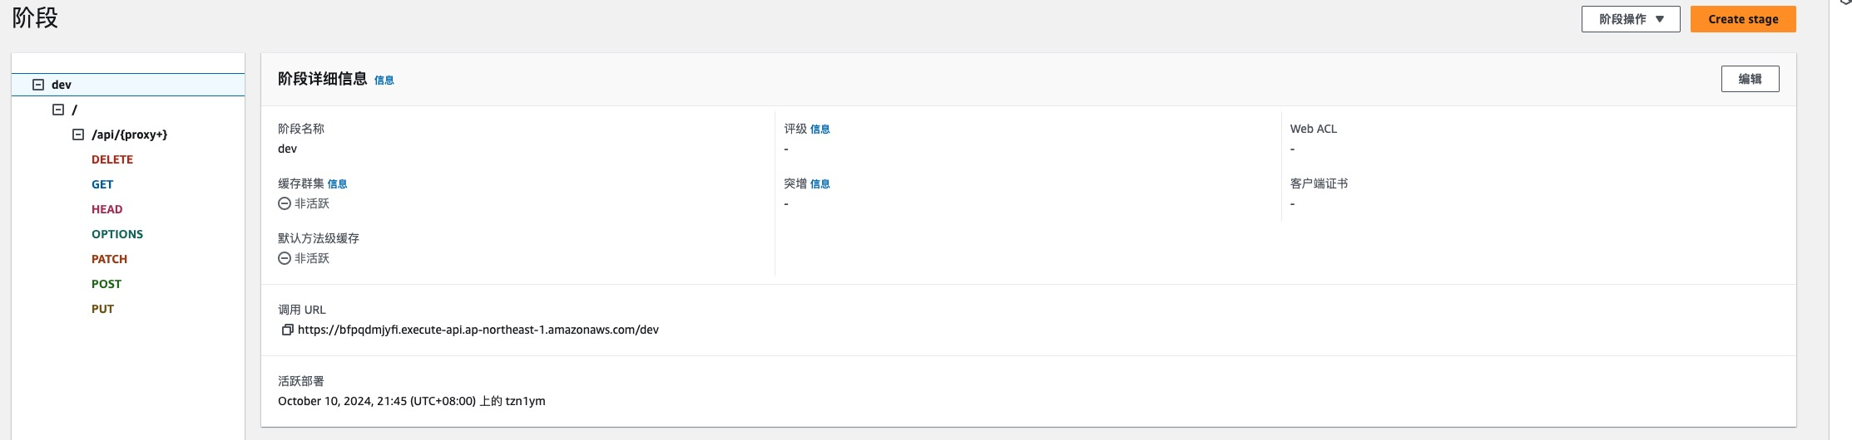
Architecture Overview ECS
Application Load Balancer
Auto scaling
th-dev.orjujeng.click/api
/dev stage
http
Target group
Amazon CloudFront
Amazon API Gateway
Elastic Load Balancing
Blue and Green

Slide 14
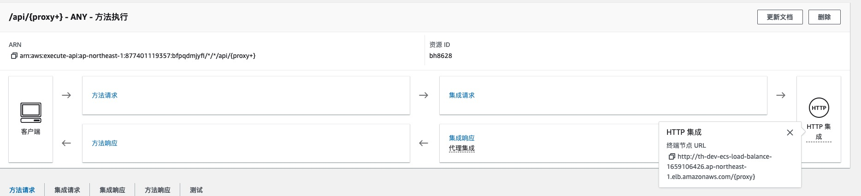
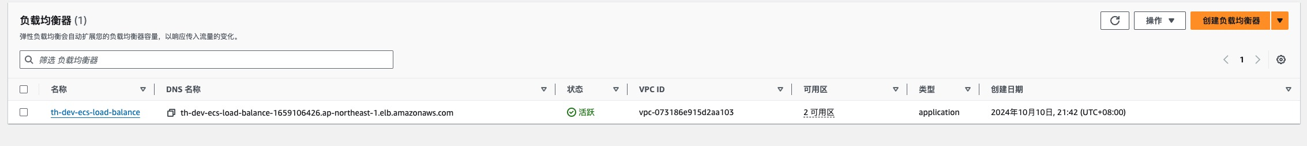
Architecture Overview ECS
Application Load Balancer
Auto scaling
th-dev.orjujeng.click/api
/dev stage
http
Target group
Amazon CloudFront
Amazon API Gateway
Elastic Load Balancing
Blue and Green

Slide 15
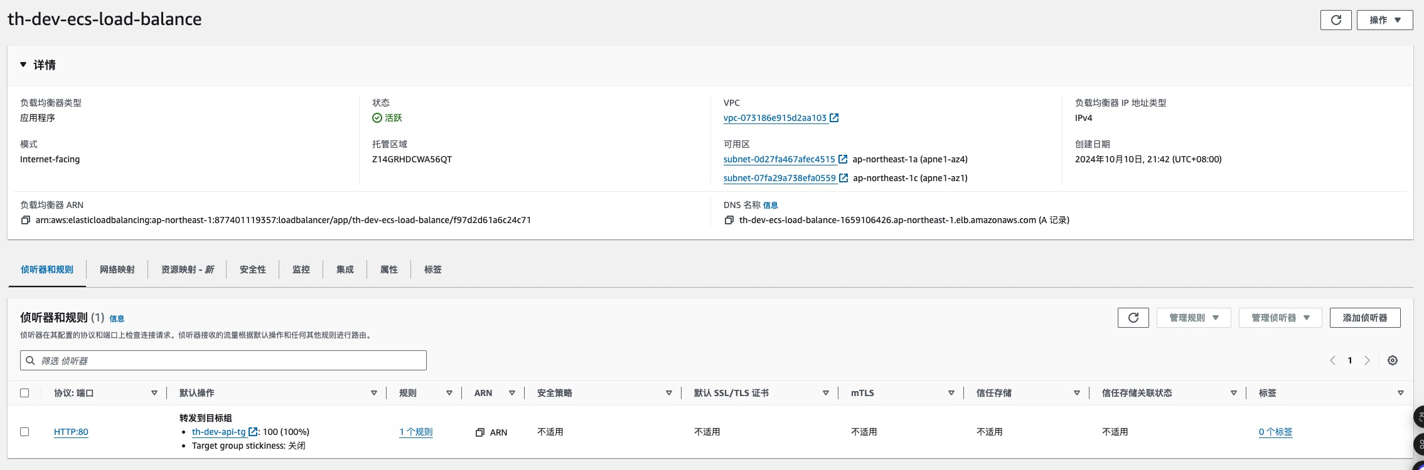
Architecture Overview ECS
Application Load Balancer
Auto scaling
th-dev.orjujeng.click/api
/dev stage
http
Target group
Amazon CloudFront
Amazon API Gateway
Elastic Load Balancing
Blue and Green

Slide 16
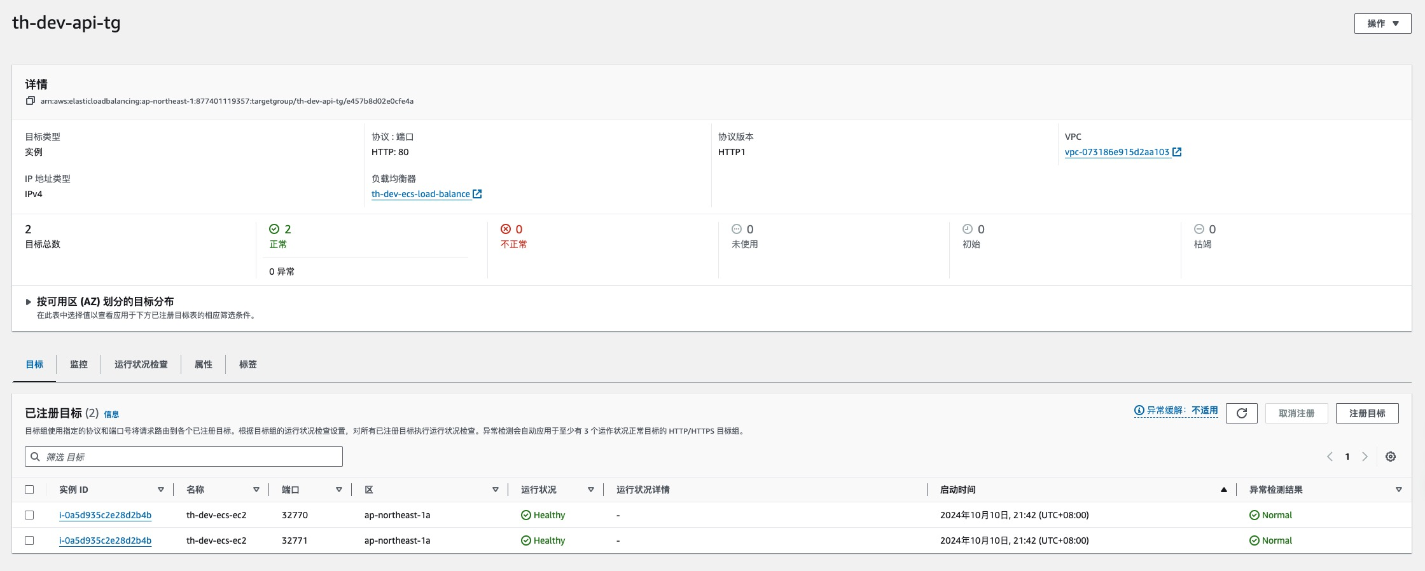
Architecture Overview ECS
Application Load Balancer
Auto scaling
th-dev.orjujeng.click/api
/dev stage
http
Target group
Amazon CloudFront
Amazon API Gateway
Elastic Load Balancing
Blue and Green

Slide 17
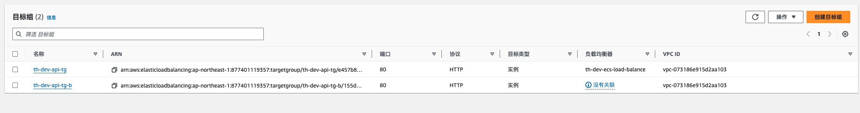
Architecture Overview ECS
Application Load Balancer
Auto scaling
th-dev.orjujeng.click/api
/dev stage
http
Target group
Amazon CloudFront
Amazon API Gateway
Elastic Load Balancing
Blue and Green

Slide 18
Architecture Overview ECS
ap-northeast-1
Auto scaling
Amazon Virtual Private Cloud (Amazon VPC)
http
Target group
Blue and Green
Availability Zone ap-northeast-1a
Public subnet
Private subnet
Instance*
bastion
DB instance
Internet gateway
Availability Zone ap-northeast-1c
Public subnet
Private subnet
Instance*
ElastiCache
for Redis

Slide 19
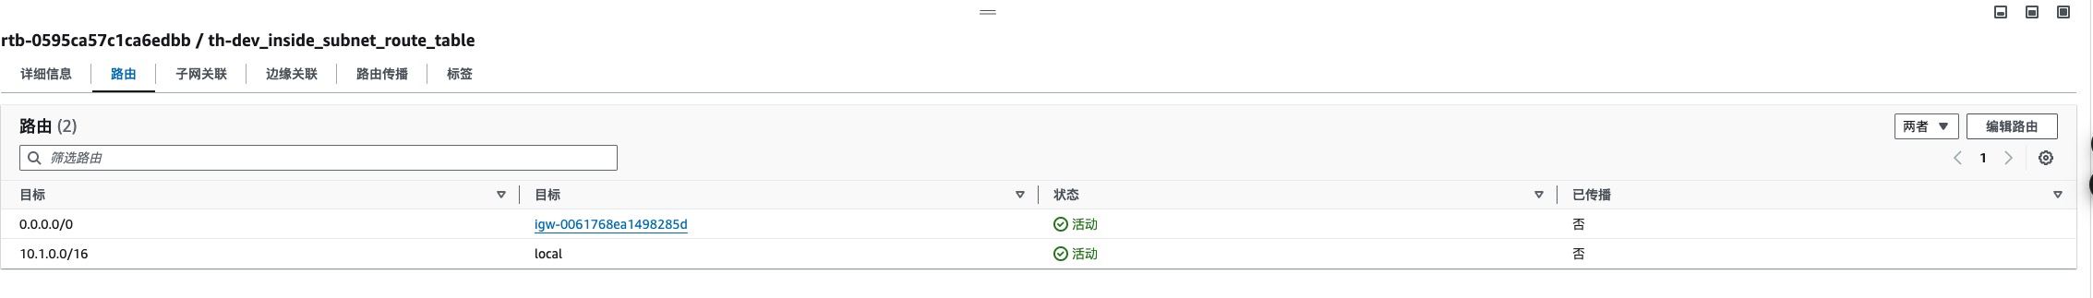
Architecture Overview ECS
ap-northeast-1
Auto scaling
Amazon Virtual Private Cloud (Amazon VPC)
http
Target group
Blue and Green
Availability Zone ap-northeast-1a
Public subnet
Private subnet
Instance*
bastion
DB instance
Internet gateway
Availability Zone ap-northeast-1c
Public subnet
Private subnet
Instance*
ElastiCache
for Redis

Slide 20
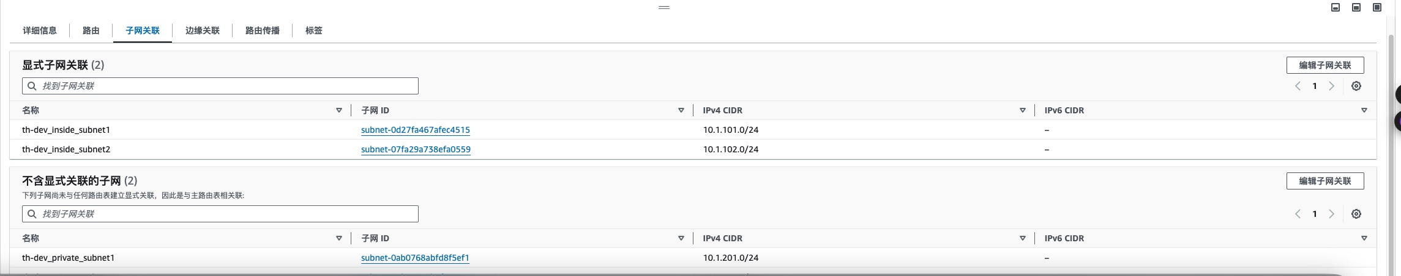
Architecture Overview ECS
ap-northeast-1
Auto scaling
Amazon Virtual Private Cloud (Amazon VPC)
http
Target group
Blue and Green
Availability Zone ap-northeast-1a
Public subnet
Private subnet
Instance*
bastion
DB instance
Internet gateway
Availability Zone ap-northeast-1c
Public subnet
Private subnet
Instance*
ElastiCache
for Redis

Slide 21
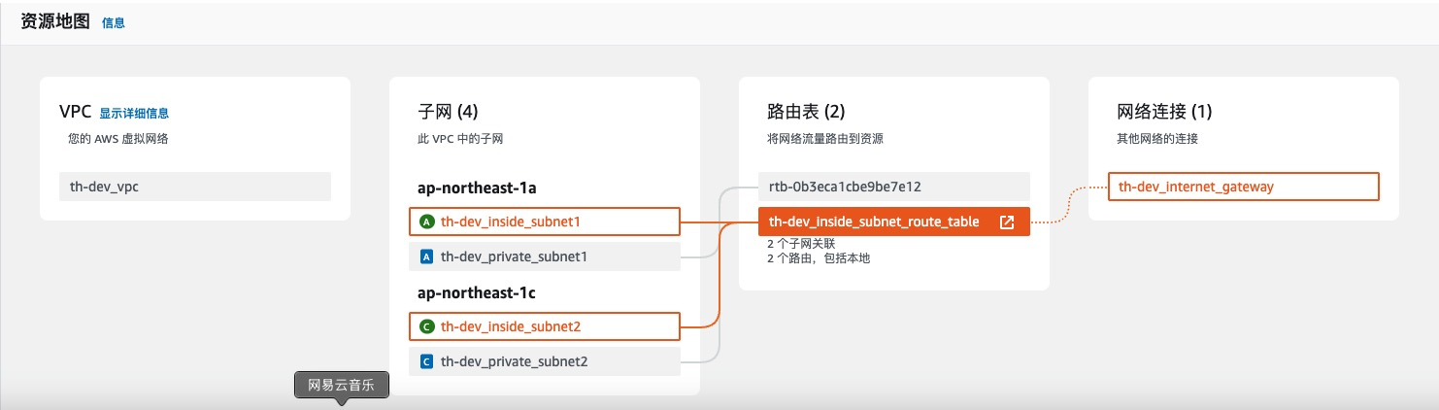
Architecture Overview ECS
ap-northeast-1
Auto scaling
Amazon Virtual Private Cloud (Amazon VPC)
http
Target group
Blue and Green
Availability Zone ap-northeast-1a
Public subnet
Private subnet
Instance*
bastion
DB instance
Internet gateway
Availability Zone ap-northeast-1c
Public subnet
Private subnet
Instance*
ElastiCache
for Redis

Slide 22
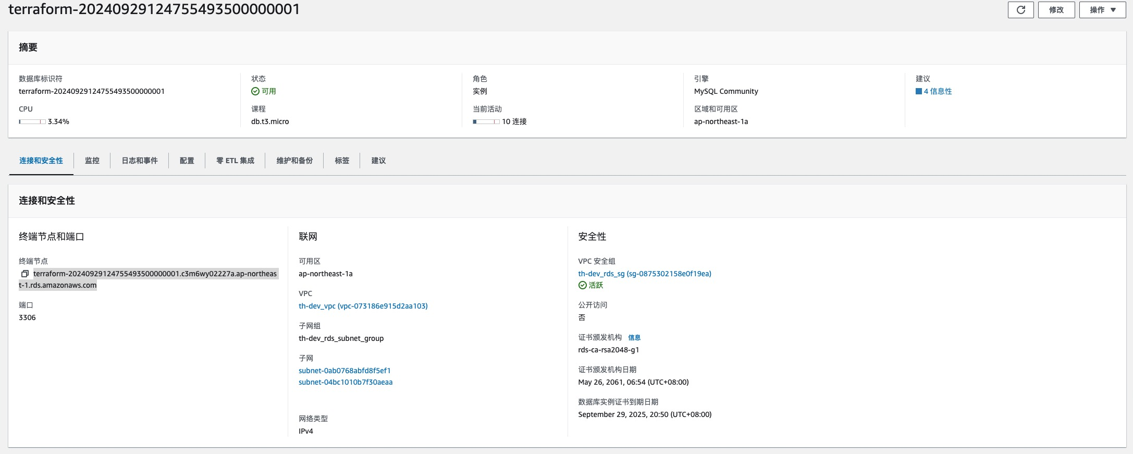
Architecture Overview ECS
ap-northeast-1
Auto scaling
Amazon Virtual Private Cloud (Amazon VPC)
http
Target group
Blue and Green
Availability Zone ap-northeast-1a
Public subnet
Private subnet
Instance*
bastion
DB instance
Internet gateway
Availability Zone ap-northeast-1c
Public subnet
Private subnet
Instance*
ElastiCache
for Redis

Slide 23
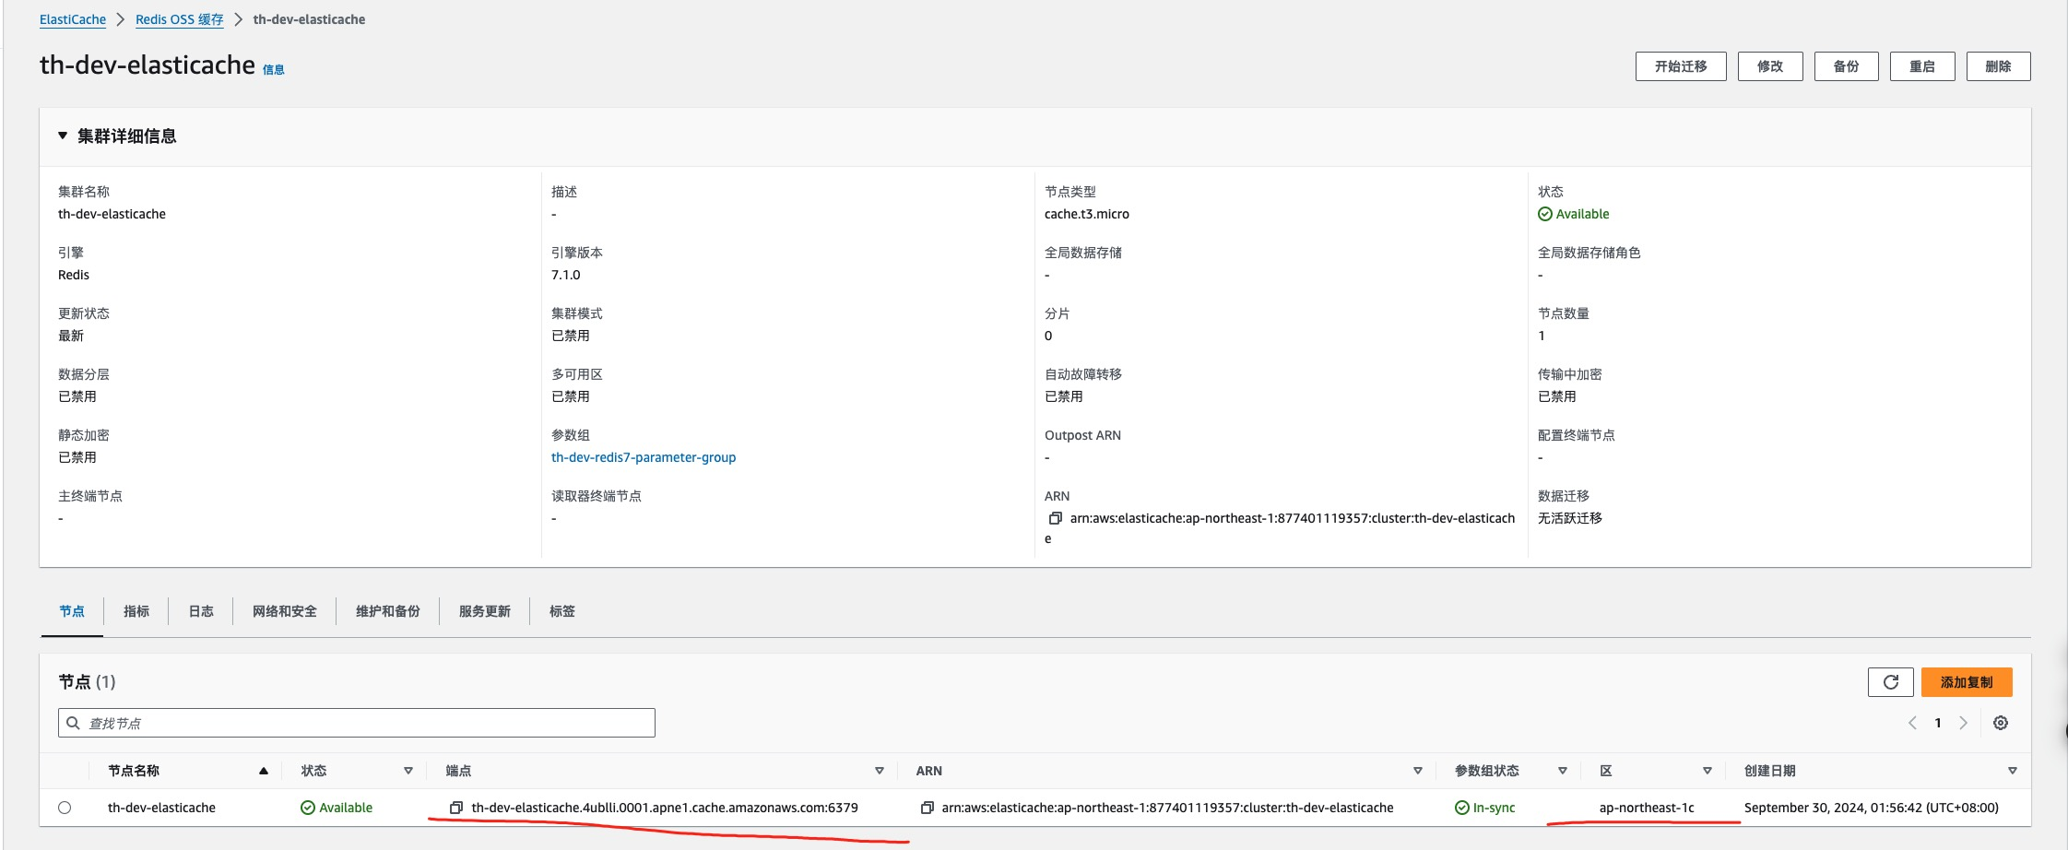
Architecture Overview ECS
ap-northeast-1
Auto scaling
Amazon Virtual Private Cloud (Amazon VPC)
http
Target group
Blue and Green
Availability Zone ap-northeast-1a
Public subnet
Private subnet
Instance*
bastion
DB instance
Internet gateway
Availability Zone ap-northeast-1c
Public subnet
Private subnet
Instance*
ElastiCache
for Redis

Slide 24
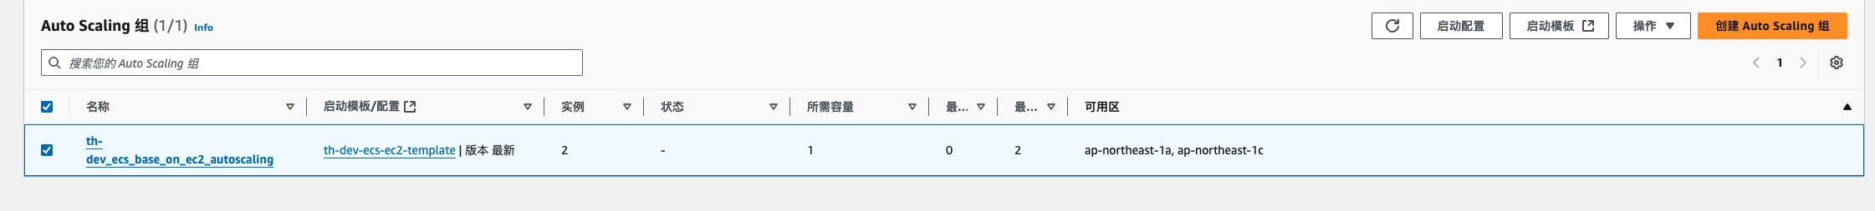
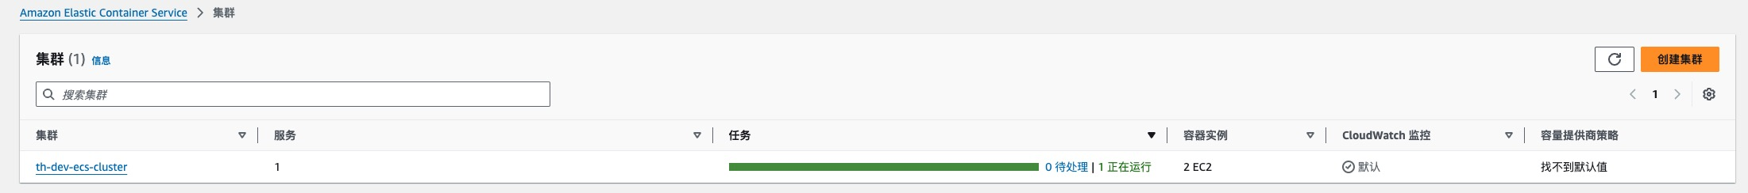
Architecture Overview ECS
Provider
Ec2 scaling
Amazon Elastic Container Service (Amazon ECS)
Service
Taskdef
Amazon Elastic Container Registry (Amazon ECR)
Task
Container 1
Container 2

Slide 25
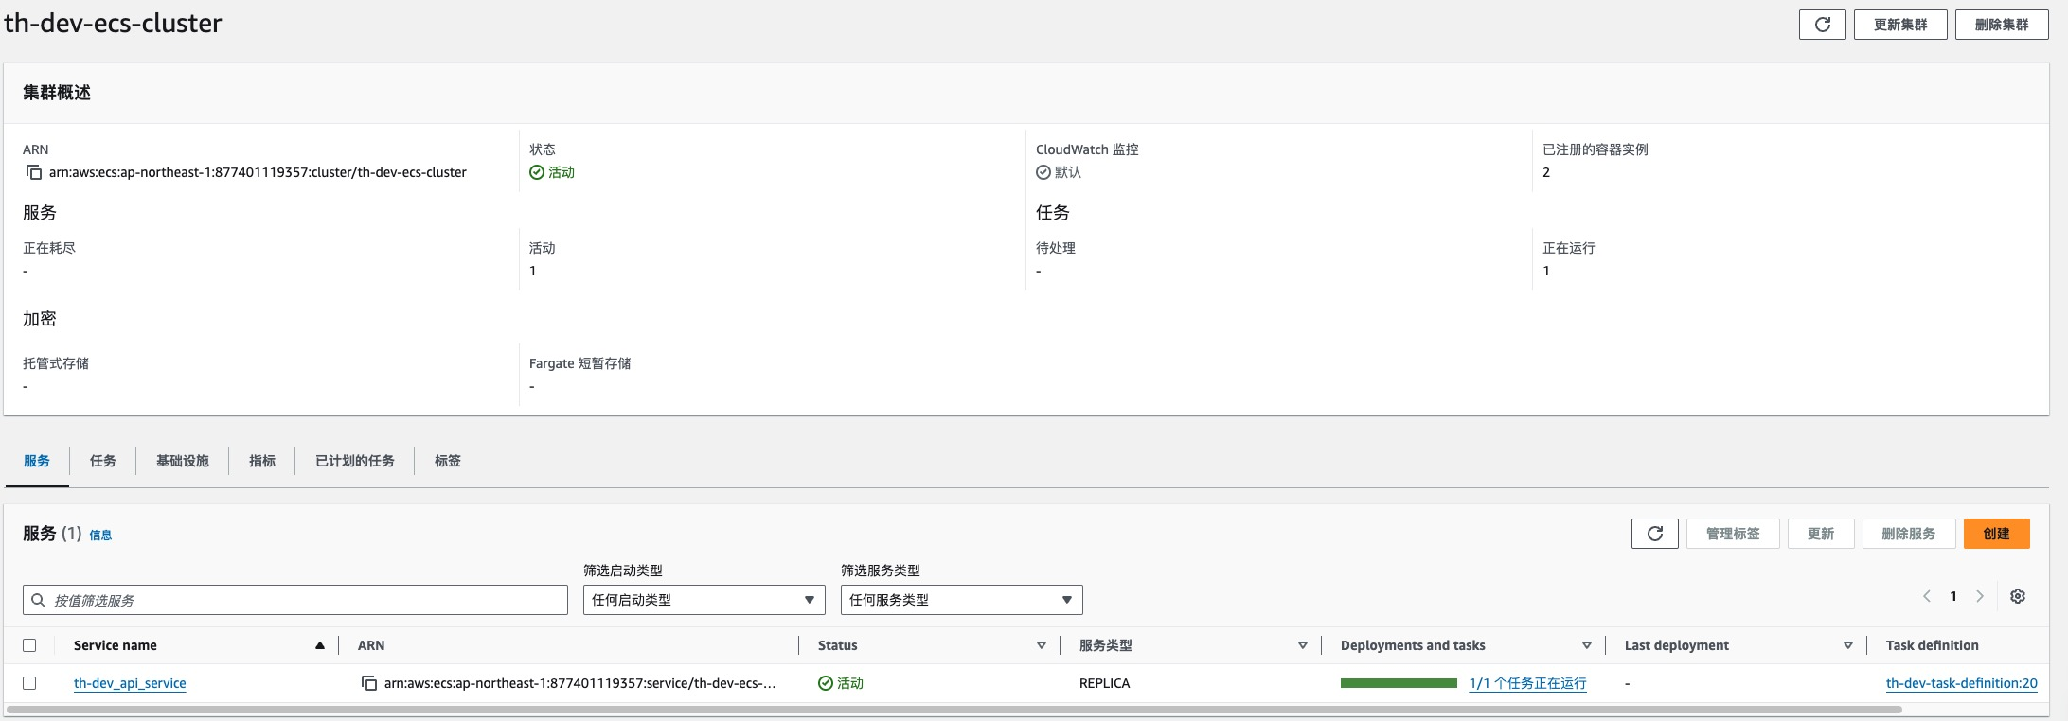
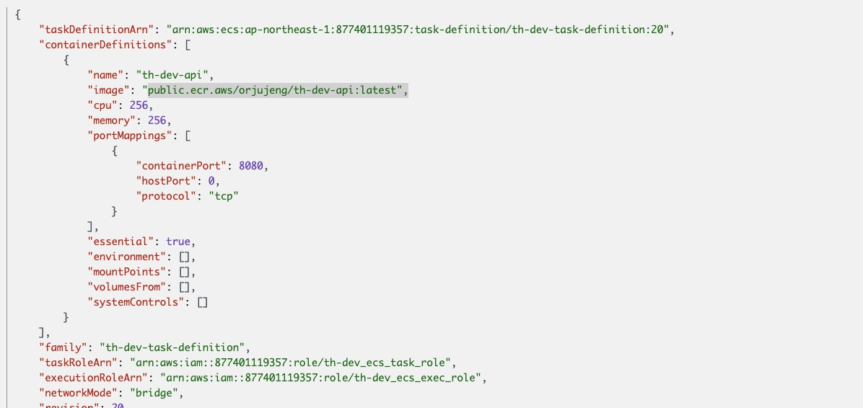
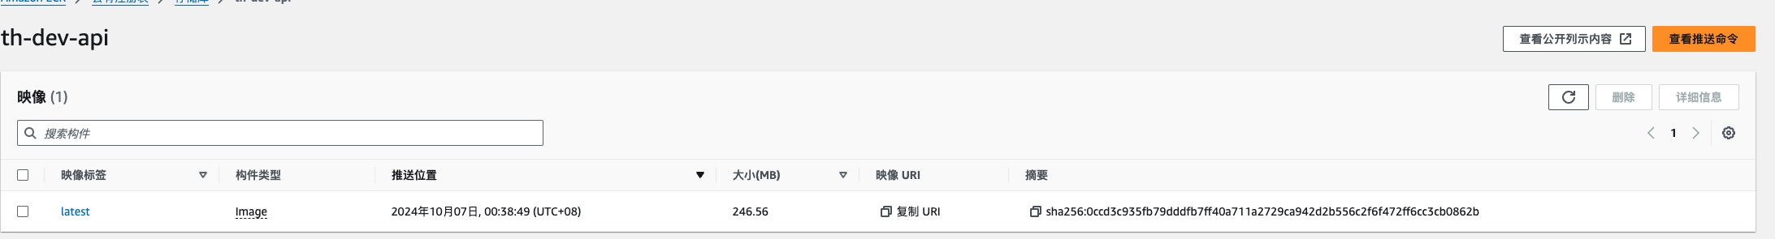
Architecture Overview ECS
Provider
Ec2 scaling
Amazon Elastic Container Service (Amazon ECS)
Service
Taskdef
Amazon Elastic Container Registry (Amazon ECR)
Task
Container 1
Container 2

Slide 26
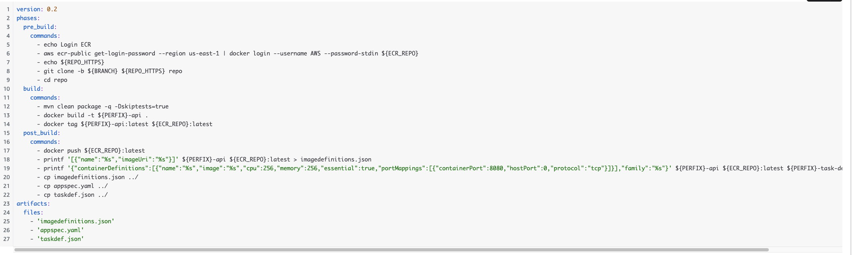
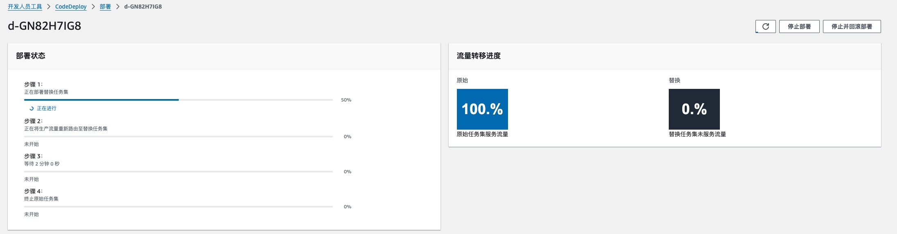
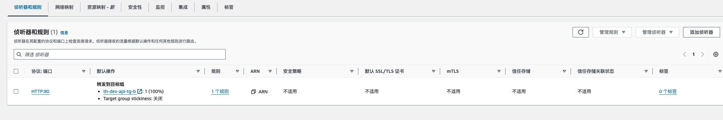
th-dev-codebuild-artifacts-orjujeng
Architecture Overview ECS
Amazon Elastic Container Registry (Amazon ECR)
Amazon Simple Storage Service (Amazon S3)
AWS CodePipeline
https://github.com/orjujeng/th-backend.git
Git
AWS CodeBuild
AWS CodeDeploy
Amazon Elastic Container Service (Amazon ECS)

Slide 27
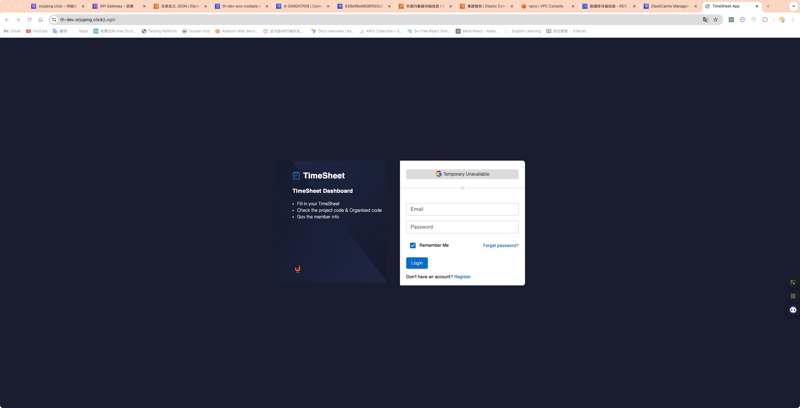

Slide 28
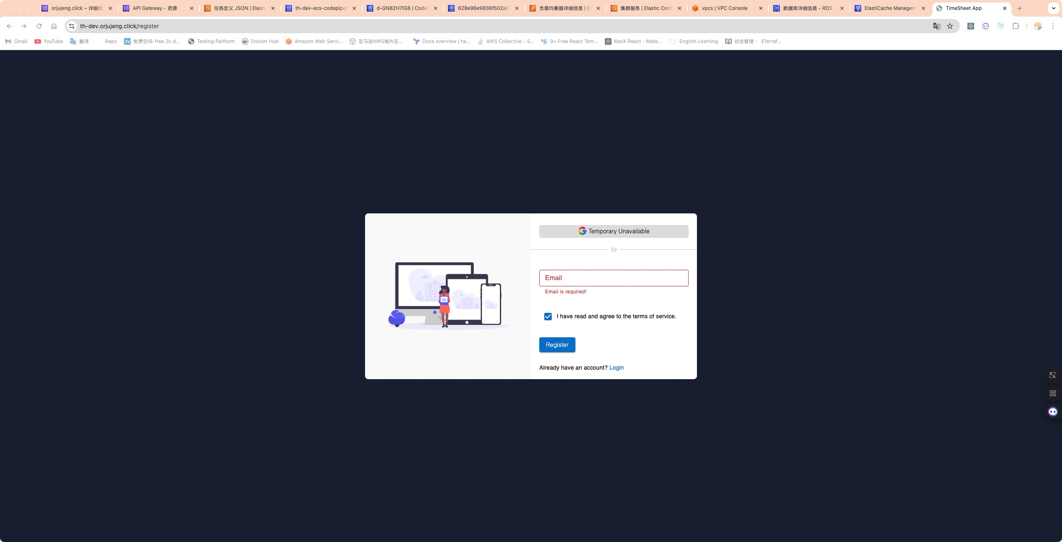

Slide 29
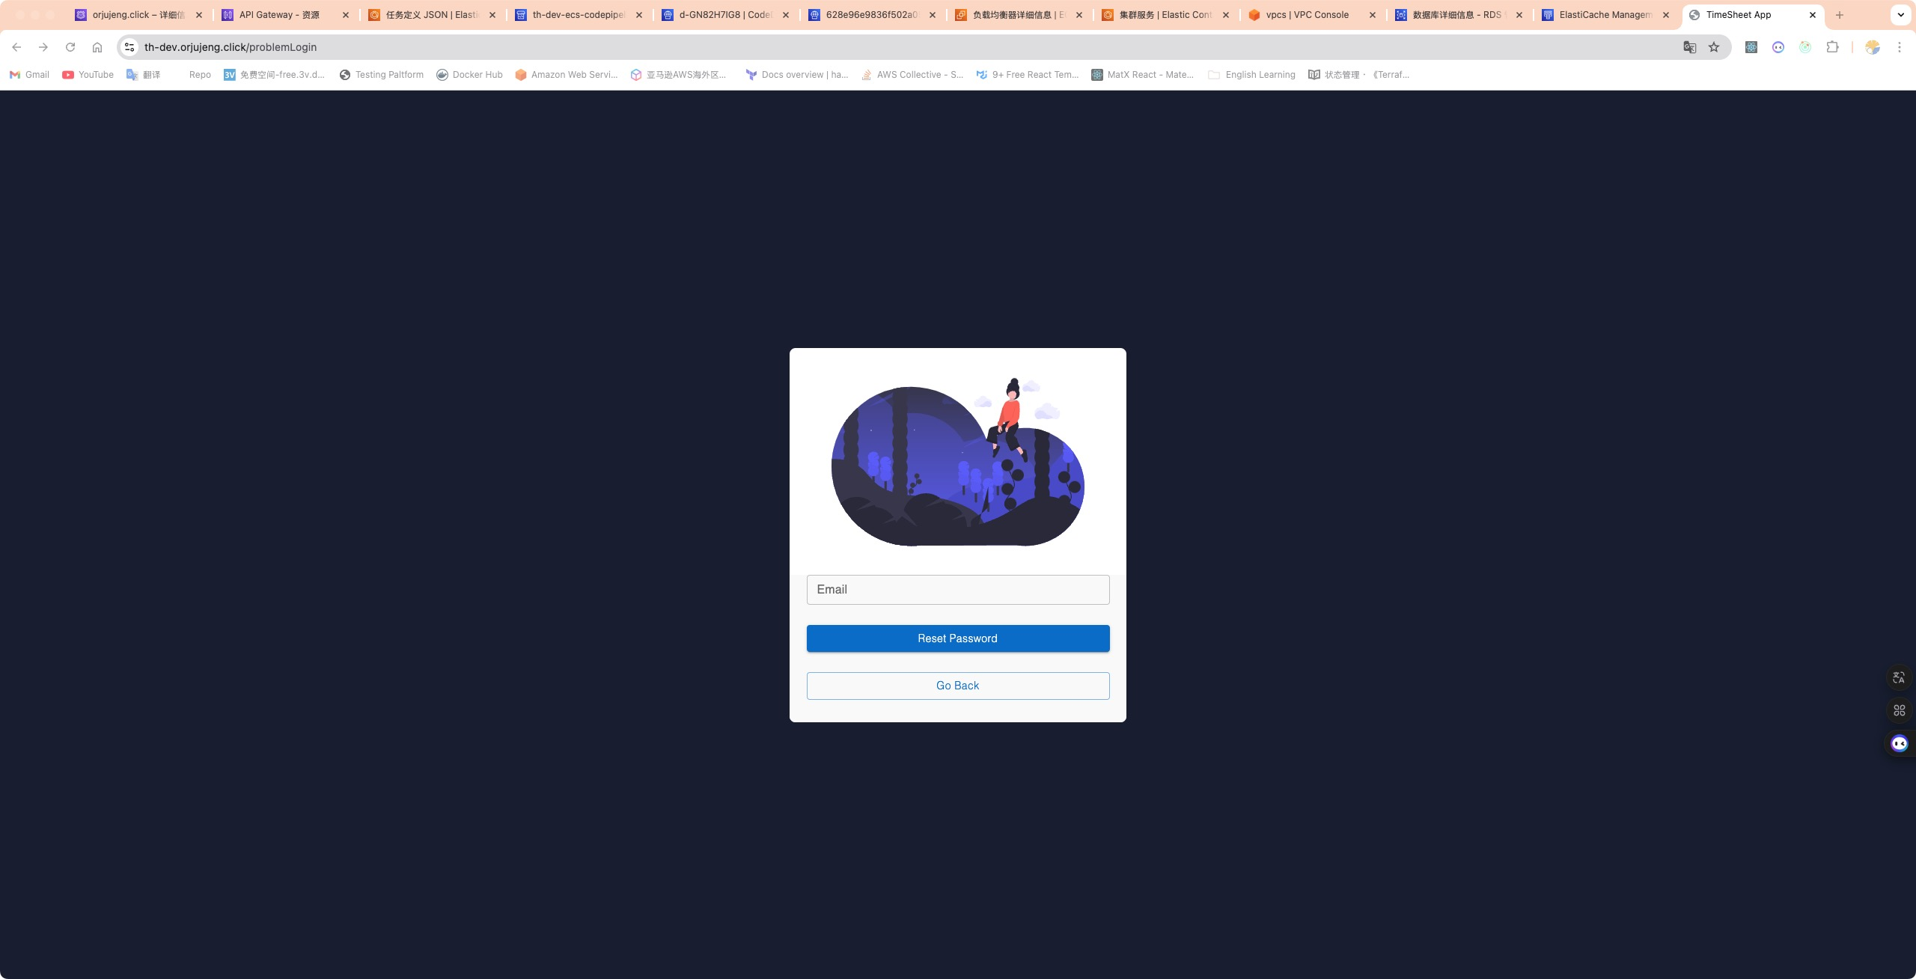

Slide 30
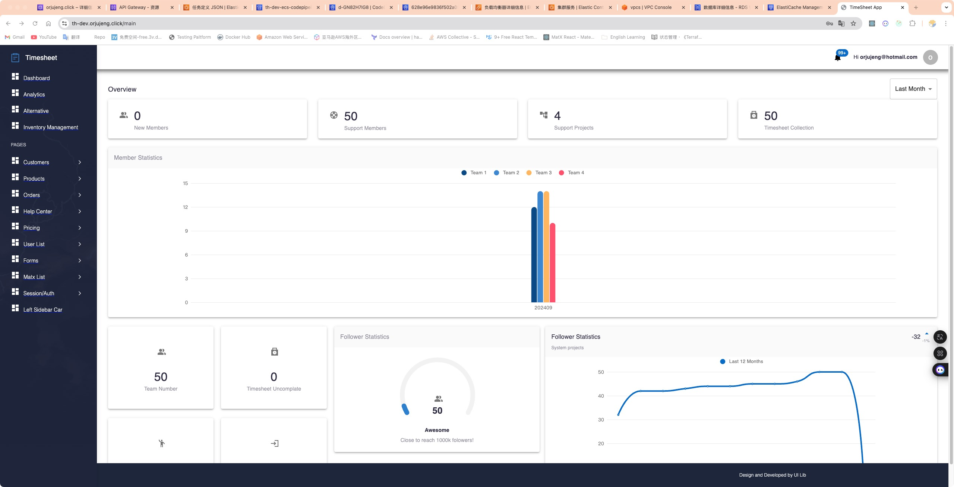

Slide 31
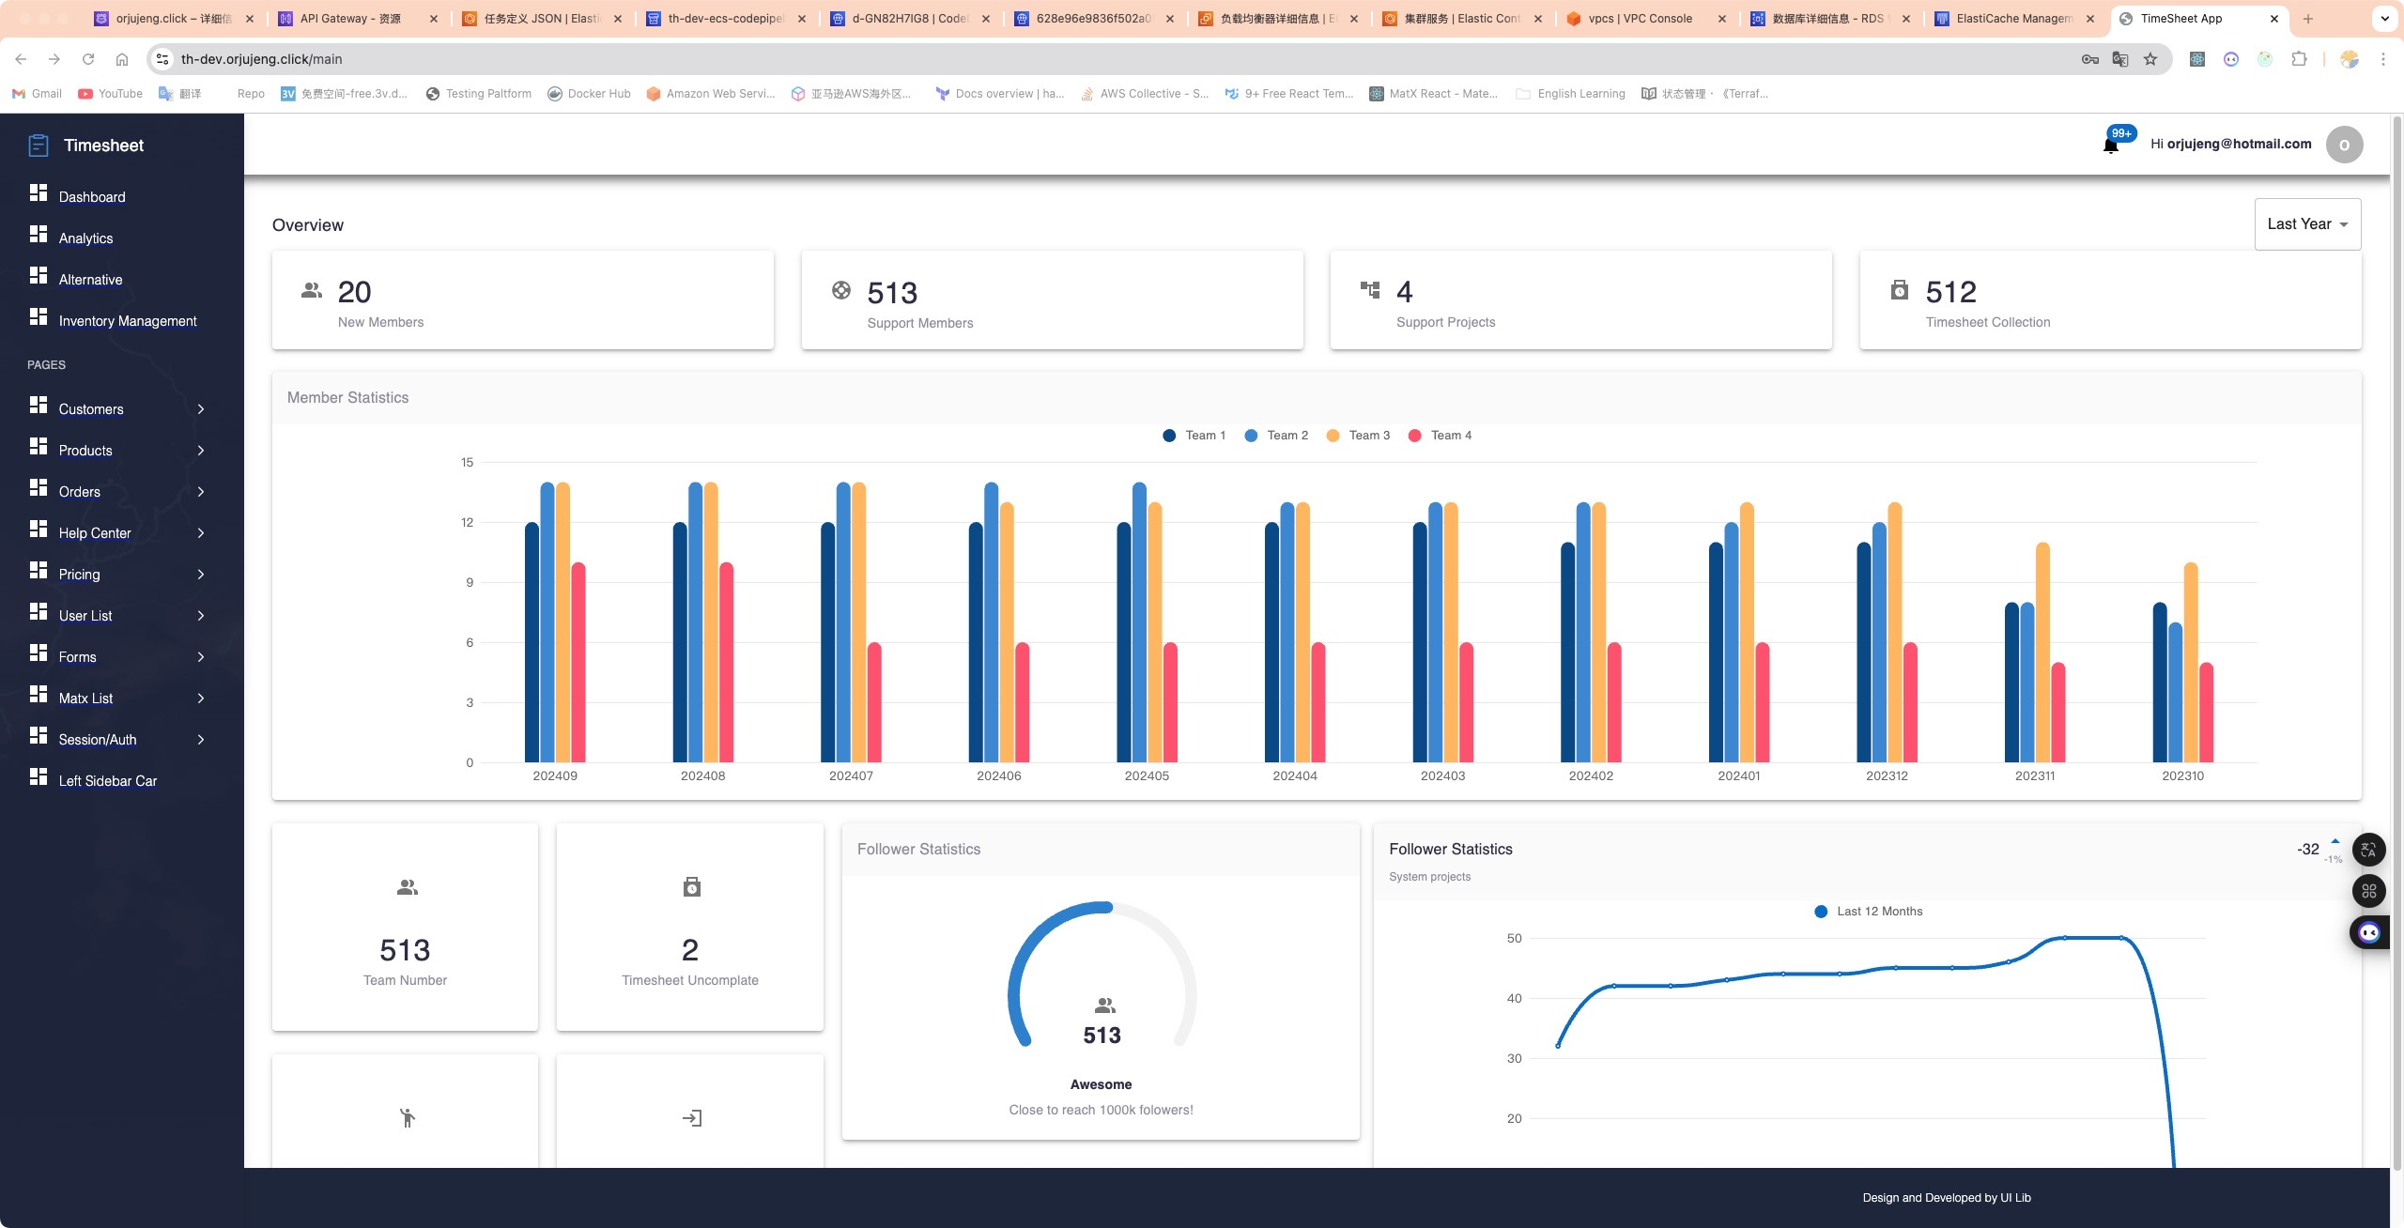

Slide 32
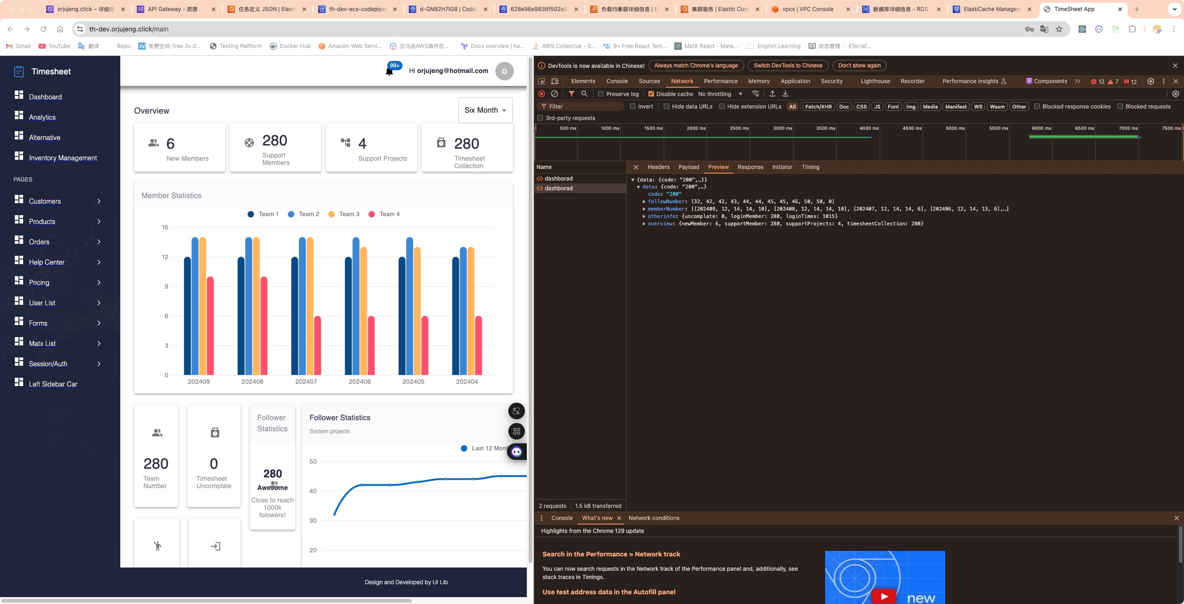

Slide 33
